Slide 1

TapWater
Stay Hydrated San Diego

Slide 2

So Here’s The Deal
Most people don’t drink enough water.
Drinking water is healthy!
Water maximizes physical performance.
Notes:
The CDC states that “forty-three percent of adults drink less than four cups of water a day. That includes 36 percent who drink one to three cups, and 7 percent who drink none.”
Drinking water aids with circulation, rids the body of toxins, and makes us feel generally better.
People who frequently exercise need to increase their water consumption to maximize their performance.

Slide 3
That’s Where We Come In
Keep track of your drinks
Don’t forget to stay hydrated
Stay connected between all your devices

Slide 4
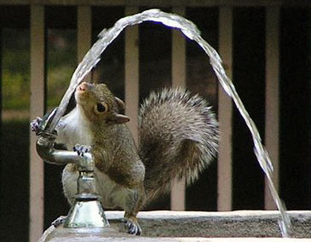
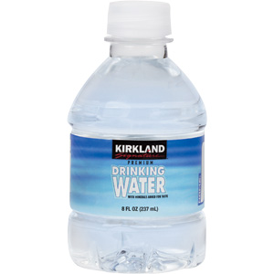
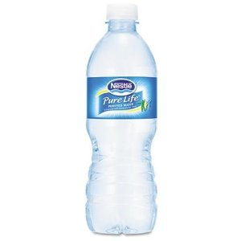
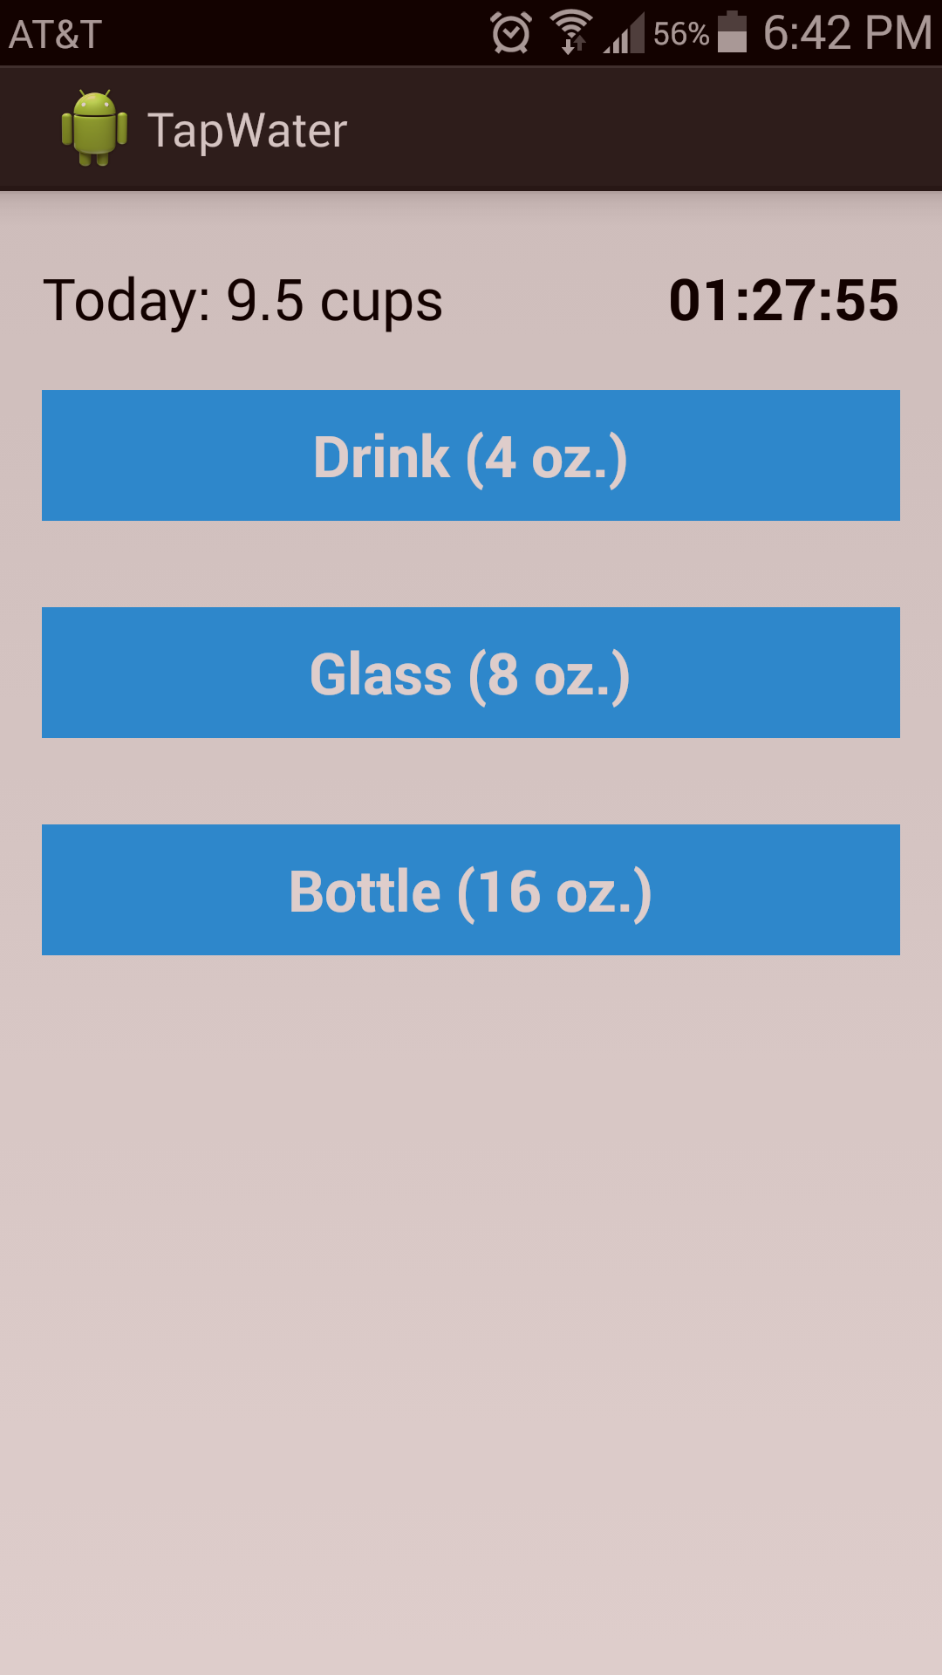
Mission Control
3 categories of drinks
Drink (4 oz.)
Glass (8 oz.)
Bottle (16 oz.)
Keep track of cups per day
Timer since last drink added

Slide 5
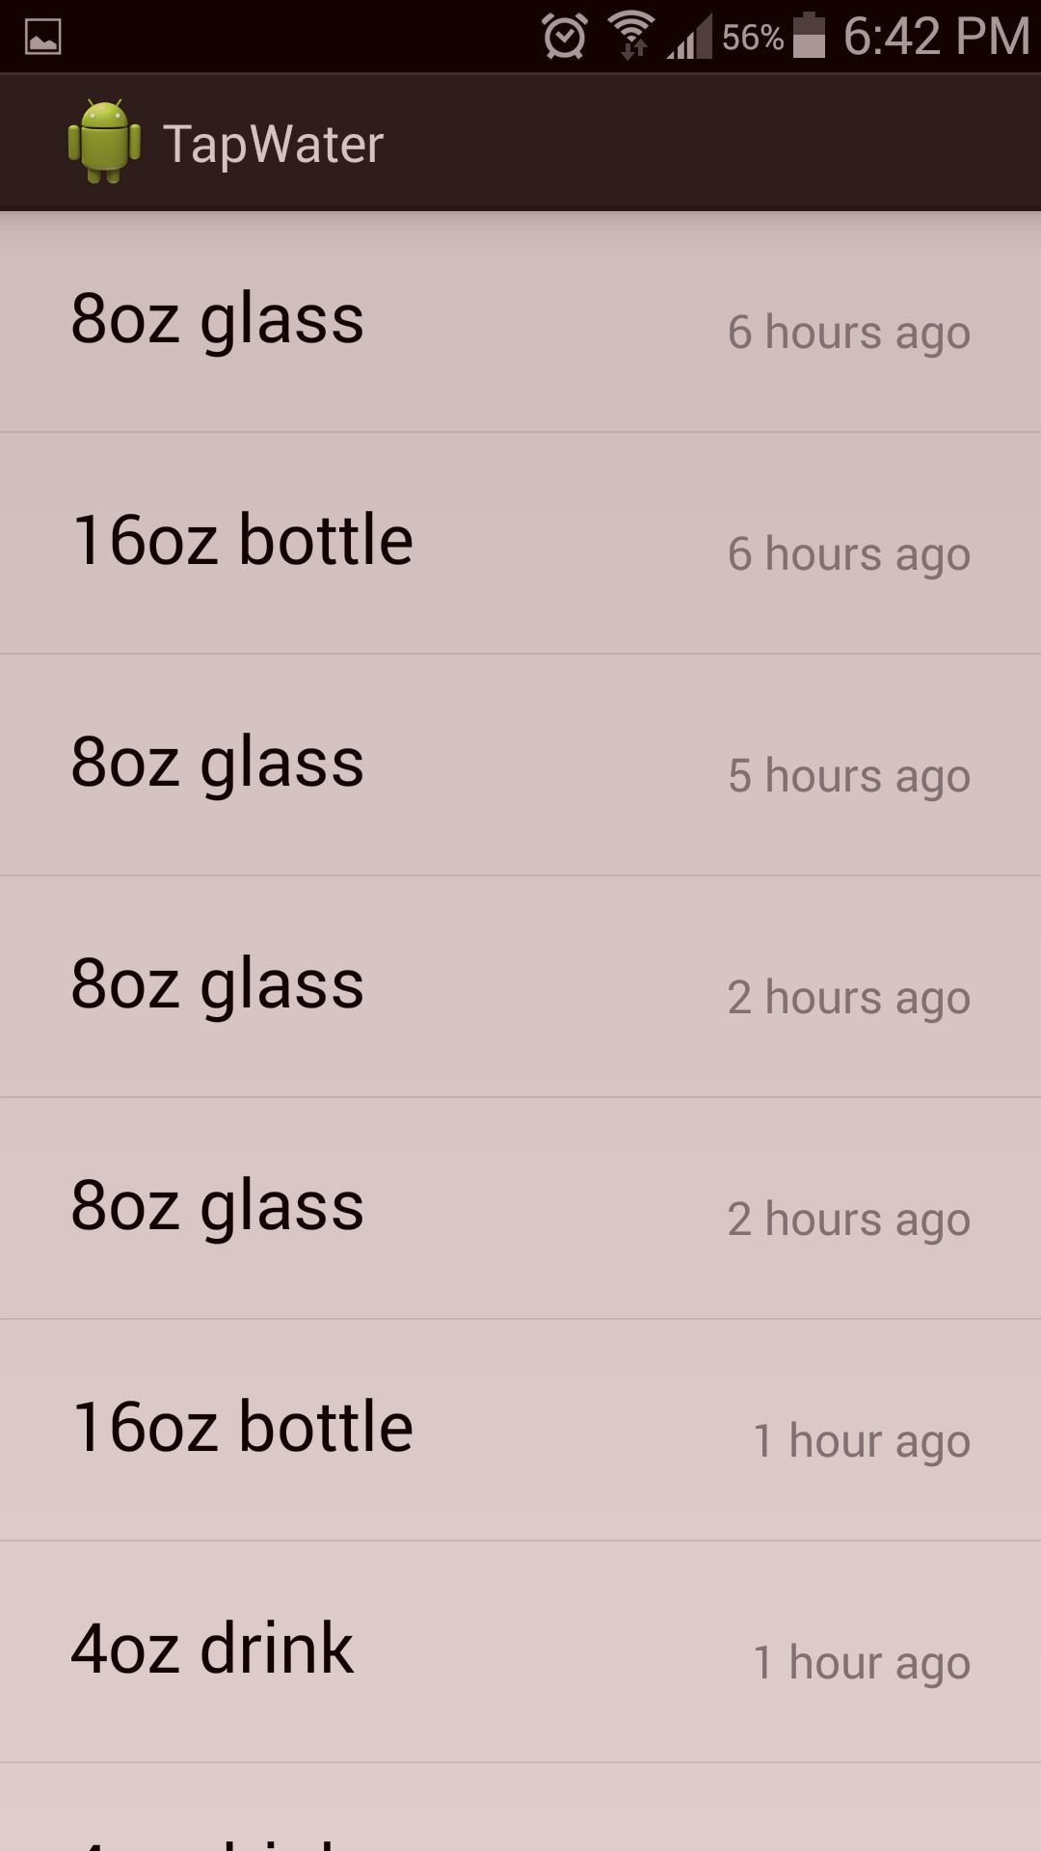
But Wait, There’s More
Review all recorded drinks for user
See when exactly each drink was added

Slide 6
Nerdy Mumbo Jumbo
Server/Back End
Ruby on Rails
Android Application
Java
iOS Application
Swift

Slide 7




End Credits
Kon-Kon Chao
Documentation
David Fontana
Documentation
Jonathon Hooper
iOS Application
Server and Web Portal
Cody Rogers
Android Application
Web Portal

